Slide 1


Customer Segmentation, Product Recommendation and Sentiment Analysis Using Artificial Intelligence
By
170030975 - PAPPU SRI VINAY TEJA (LEADER)
170030586 - KATTA LIKHITHA CHOWDARY
170031376 - VELIVELA VENKATA SIVA RAM KUMAR

Slide 2
Abstract
Our project is Customers Segmented based on demographics, geographical, psychographics and behavior of customer.
Recommending the products based on the:
Customer interest.
Products he buy.
Products he search.
Applying Sentiment Analysis on product review given by customer.

Slide 3
Introduction
Product Marketing is the very important process of promoting and selling a product to a customer.
Product Marketing had 7 steps:
Understand your audience
Know your product
Create a plan
Prepare to education
Promote, promote, and promote some more
Learn what’s working
Hit repeat

Slide 4
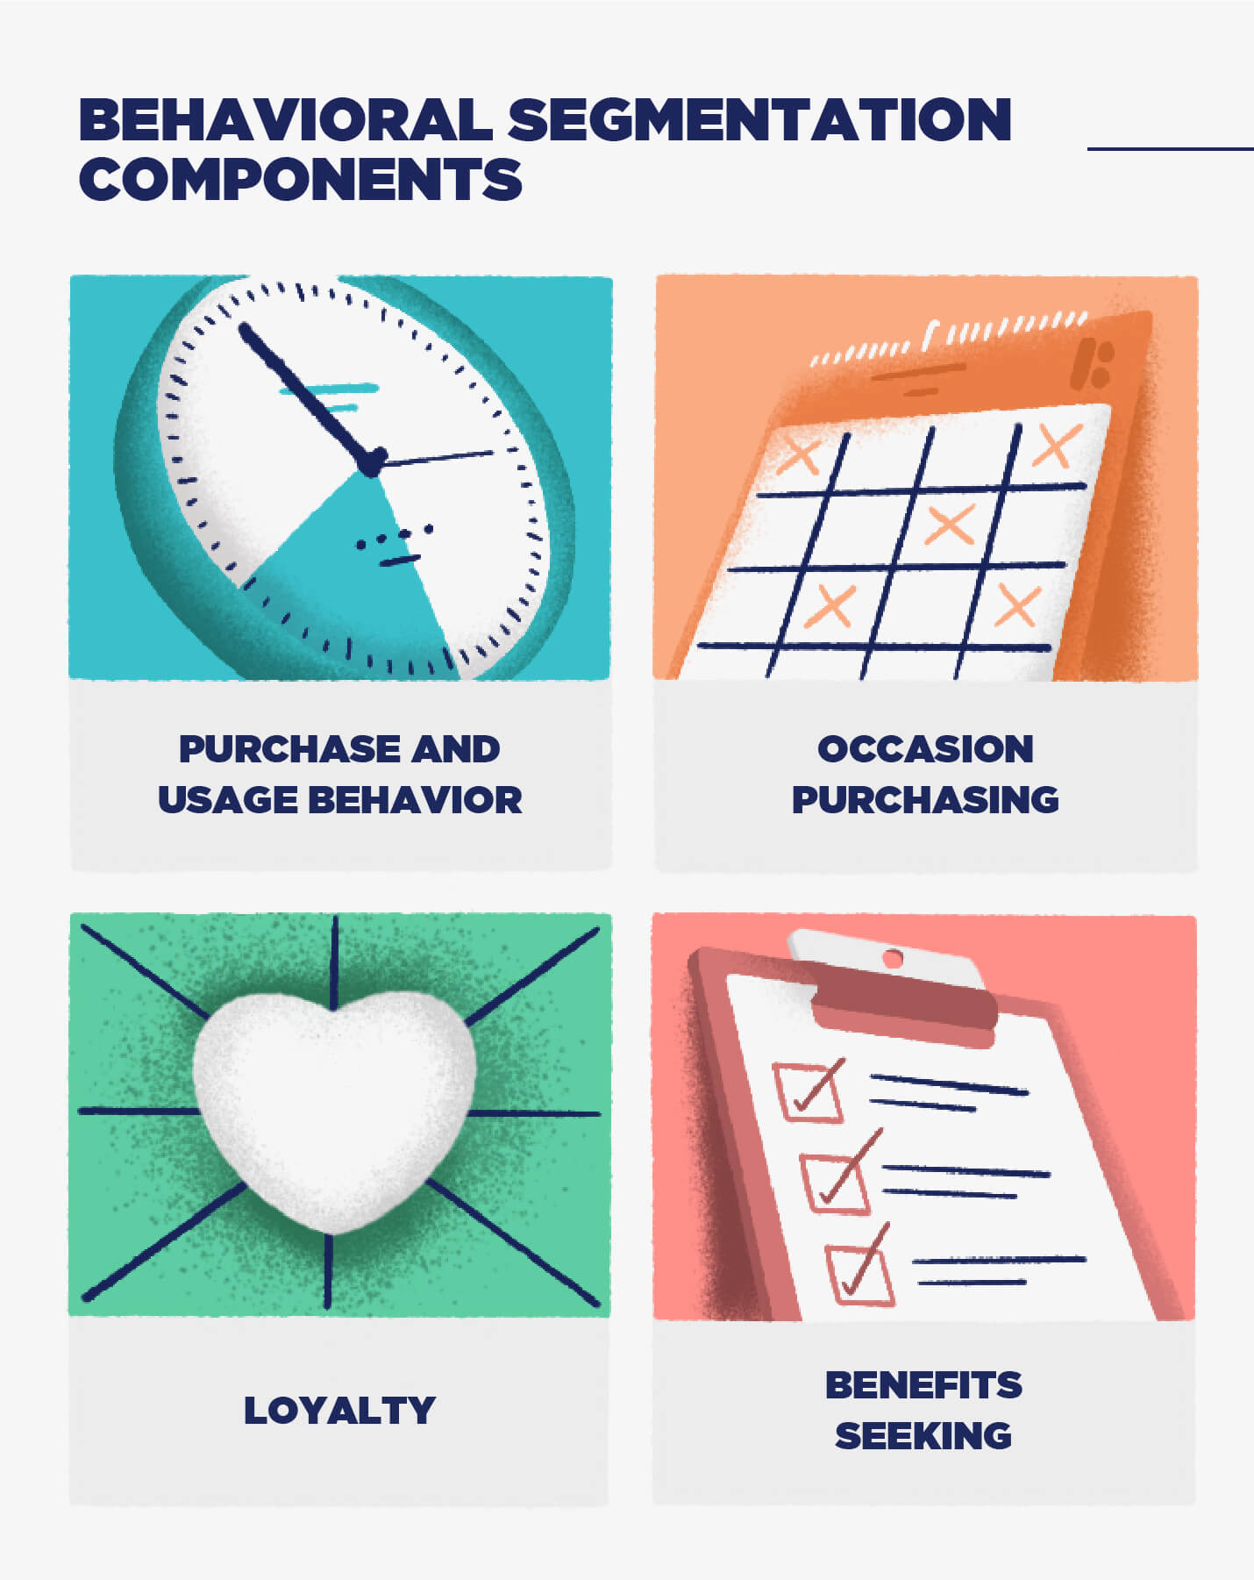

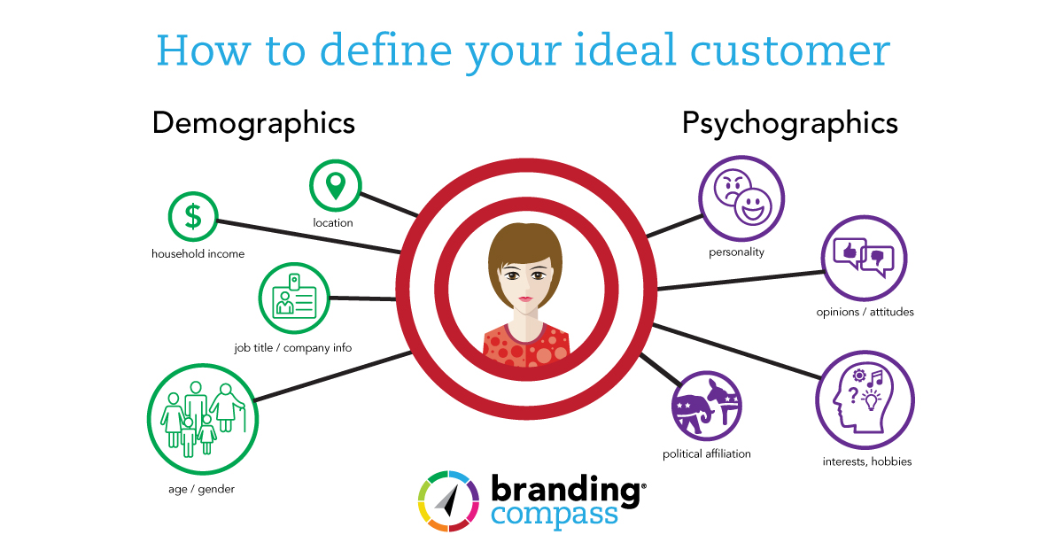
Customer Segmentation
One of the fundamental ways in which businesses understand their customers is through segmentation.
Typically, customers are segmented based on geographics, demographics, psychographics, behavior etc.
To target them with the right products and offers.

Slide 5
Customer Segmentation Types
Customer Segmentation based on demographics
01
Customer Segmentation based on psychographic
03
Customer Segmentation based on behavior
04
Customer Segmentation based on geographic
02

Slide 6
Customer Segmentation Types - Sub
Age, Gender, income, religion, education level, occupation, etc
01
Attitude, values, personality, lifestyle, interest, opinion
03
State, country, climate conditions, language
02
Which product, purchase frequency, cost, quantity, occasion, rating
04

Slide 7
Product recommendation
Product recommendation is one type of marketing.
Our product is recommended based on the customer previous purchased, search history.
If any two customers have similarities then recommend the product to each others

Slide 8
Sentiment Analysis
To know whether our product is a success or failure the only way is customer review and customer rating.
The sentiment analysis one type of text analysis.
It help to find whether the give review is positive publicity, negative publicity or neutral publicity.

Slide 9
WORKFLOW USED IN ARTIFICIAL INTELLIGENCE
1. Get the data
3. Get the answers
5. Check the quality of dataset
7. Use the answers
2. Prepare Questions
4. Add data into table
6. Transform Feature

Slide 10

Modules
Module - 1
With the help of K – Mean Clustering using Elbow Method we are going to find:
Which product are attracting the customer
Which group of customer buying the product
In which area was the product is sell more
Etc..

Slide 11
K - Means Clustering using Elbow Technique
K - Means algorithm split the data set into fixed number of clusters.
The elbow method runs k-means clustering on the dataset for a range of values for k and then for each value of k computes an average score for all clusters.
K-Means Clustering split the dataset into various fixed numbers of clusters to find various center points called Centroids are used to train KNN classifier.

Slide 12

Module – 2
With the help of Content based Filtering using Cosine Similarity we are going to find
The product they like more
The product they buy frequently

Slide 13
Content Based Filtering using Cosine Similarity
Content-based filtering uses item features to recommend other items similar to what the user likes, based on their previous actions.
Cosine similarity measures the similarity between two vectors of an inner product space.
It is measured by the cosine of the angle between two vectors and determines whether two vectors are pointing in roughly the same direction.
It is often used to measure document similarity in text analysis.

Slide 14
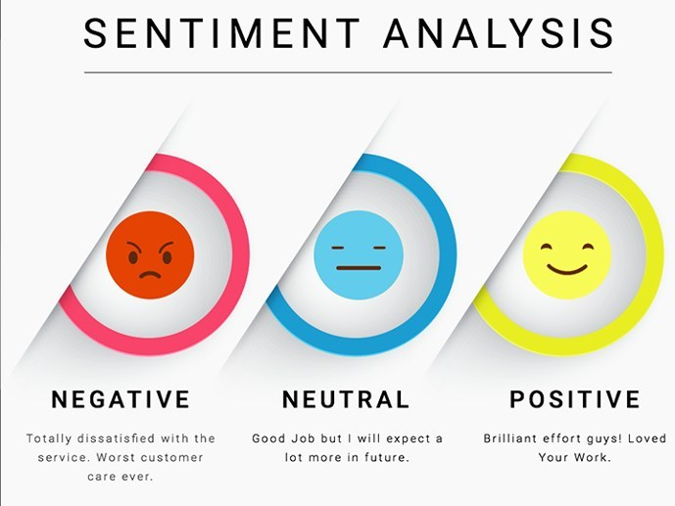
Module – 3
With the help of Sentiment Analysis Model and Linear Regression we are going to find:
Was the product is a success or failure
Does the product have any issues
Does the product was like by customer or not.

Slide 15
Sentiment Analysis using Linear Regression
Sentiment Analysis uses a chunk of text to know whether it is positive, negative or neutral.
By using the linear regression we plot a graph which gives the predict value of a variable based on the value of another variable.

Slide 16
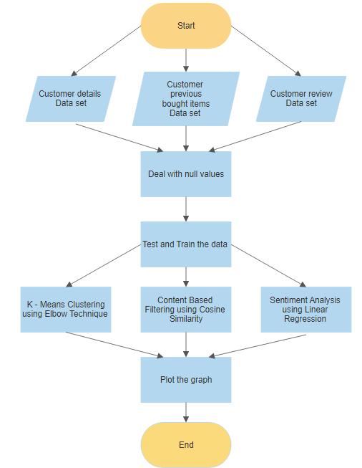
Flow Chart

Slide 17
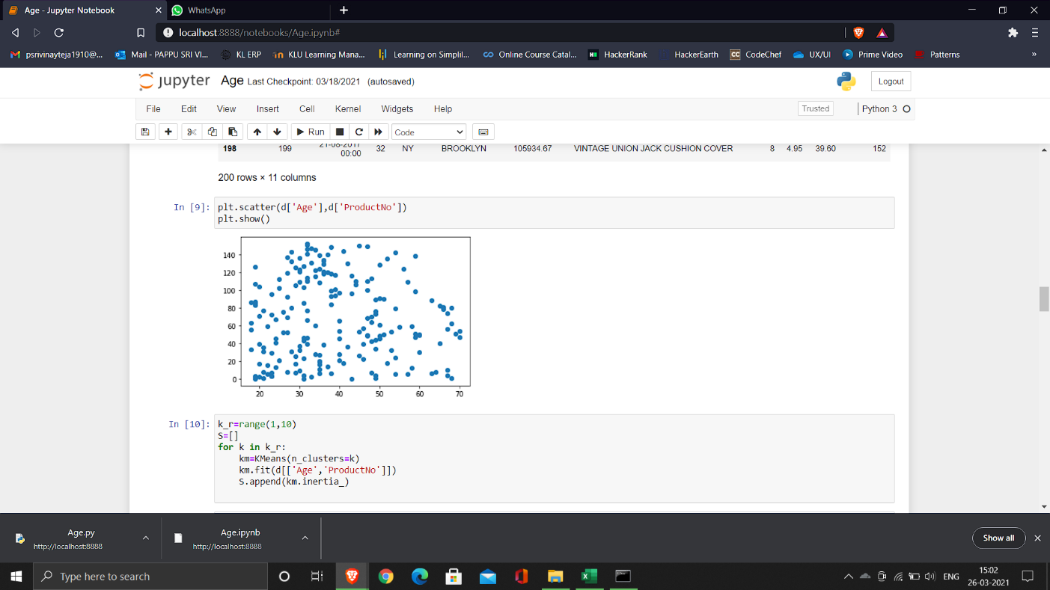
Result
Fig 1.0: Graph of Age dataset

Slide 18
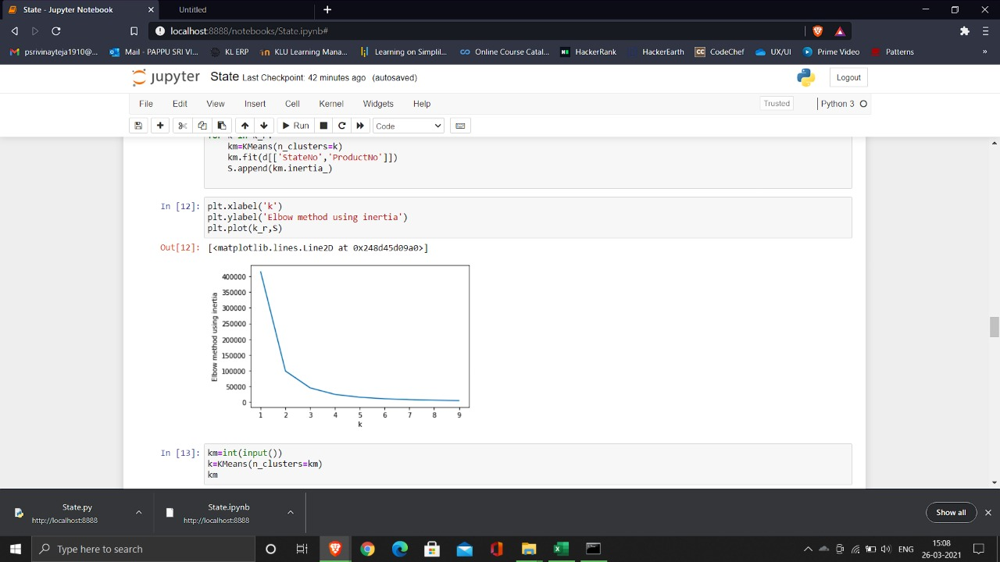
Fig 1.1: Elbow graph to know the minimum number of clusters for age dataset

Slide 19
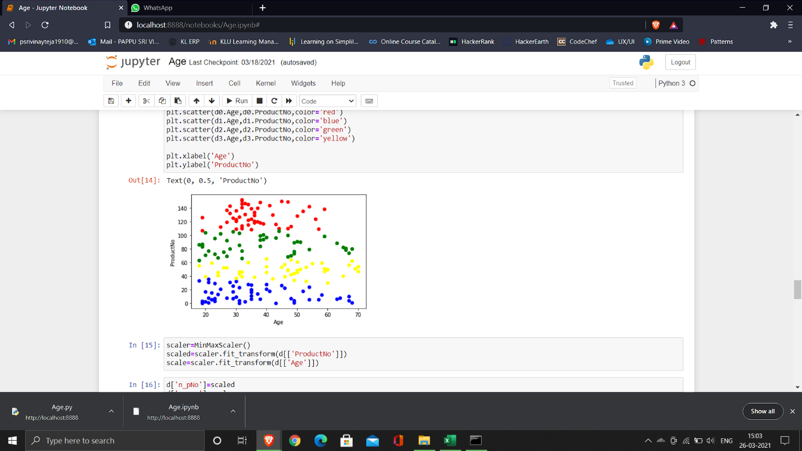
Fig 1.2: Graph of clusters of age dataset

Slide 20
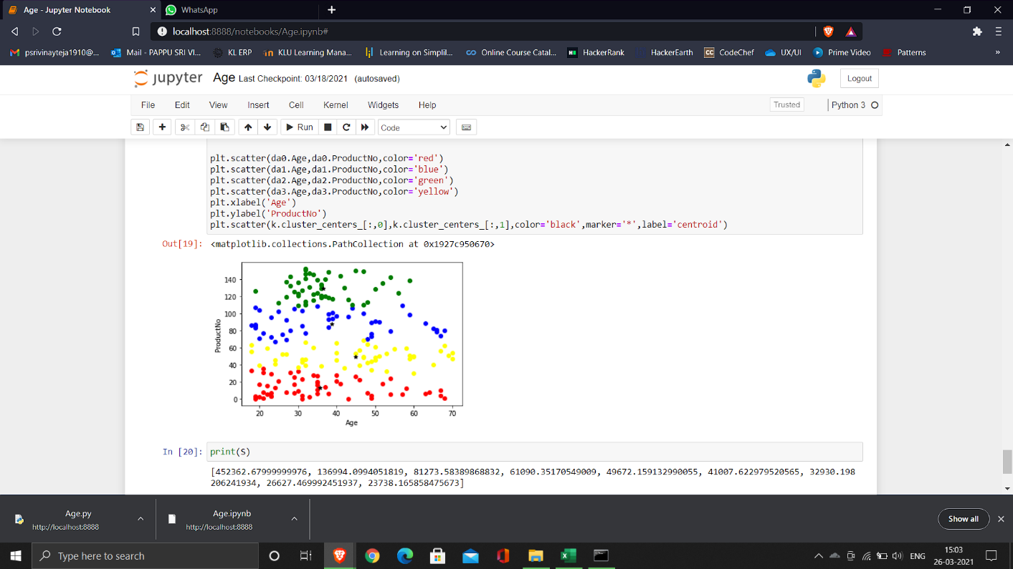
Fig 1.3: Graph of cluster of age dataset with their centroids

Slide 21
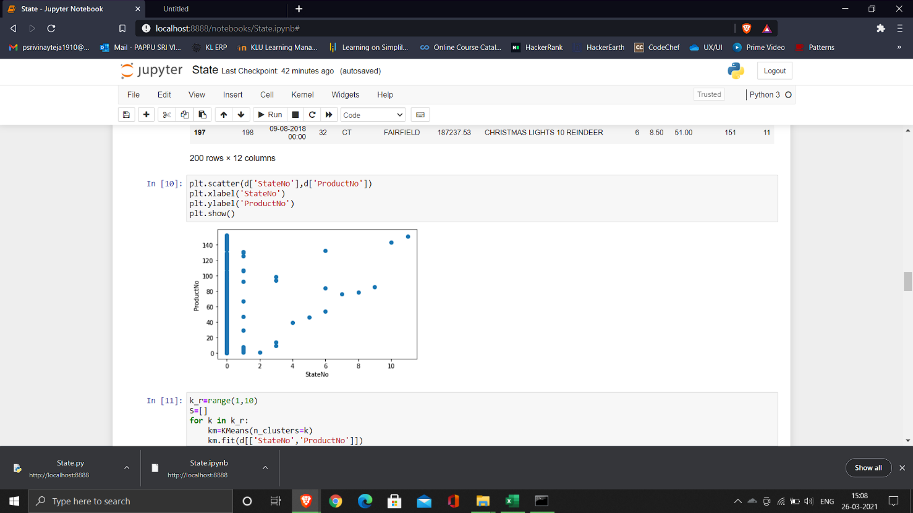
Fig 2.0: Graph of State dataset

Slide 22

Fig 2.1: Elbow graph to know the minimum number of clusters for state dataset

Slide 23
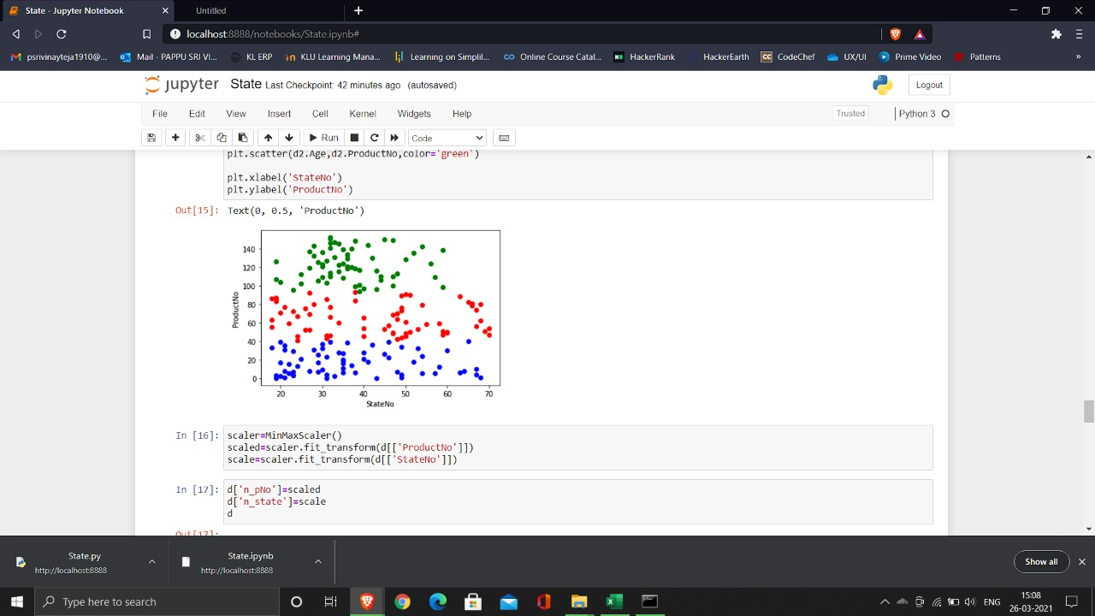
Fig 2.2: Graph of clusters of state dataset

Slide 24
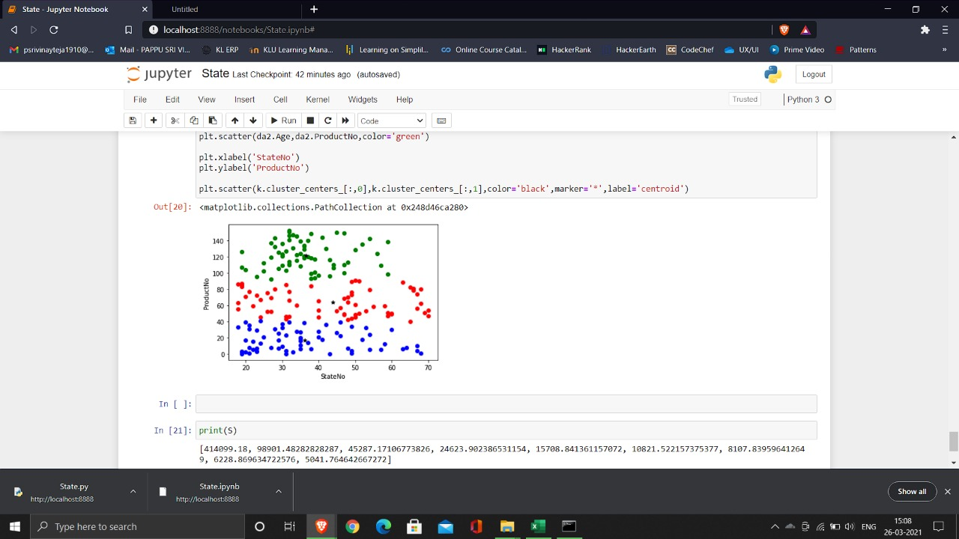
Fig 2.3: Graph of cluster of state dataset with their centroids

Slide 25
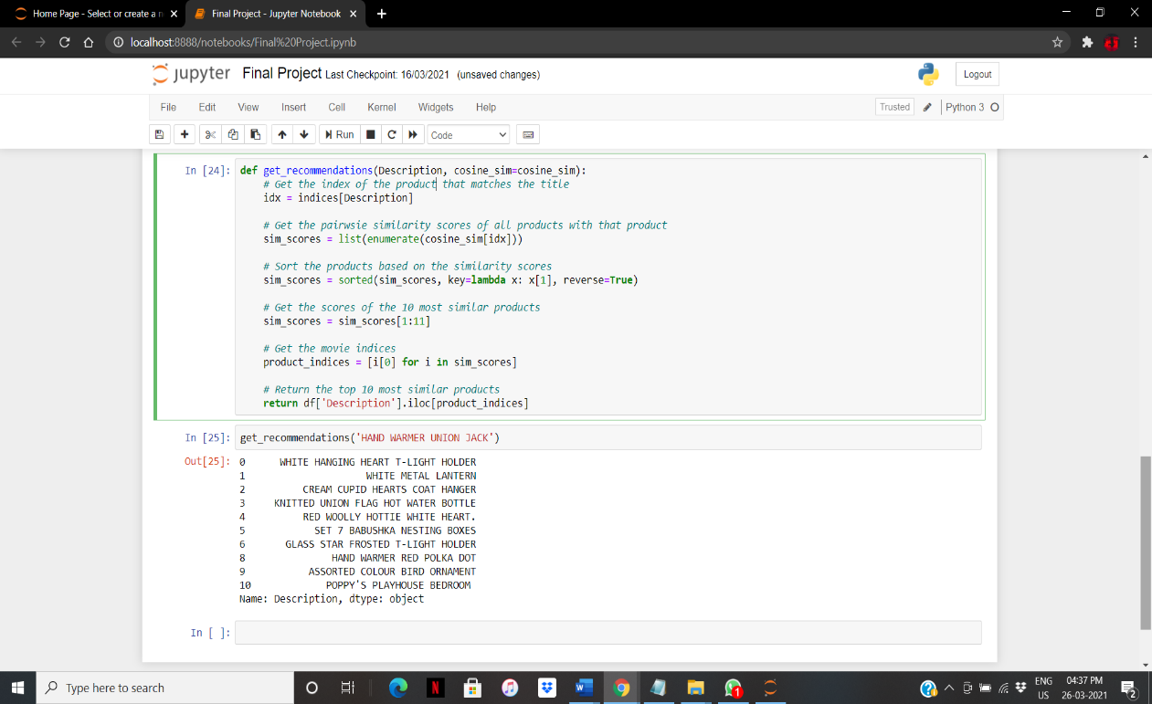
Fig 3.1: Output of recommended item1

Slide 26
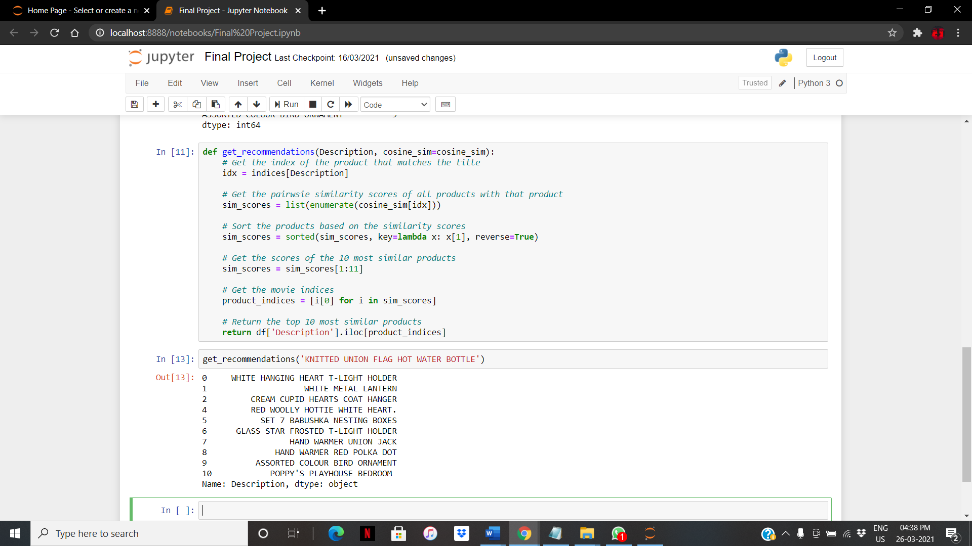
Fig 3.2: Output of recommended item2

Slide 27
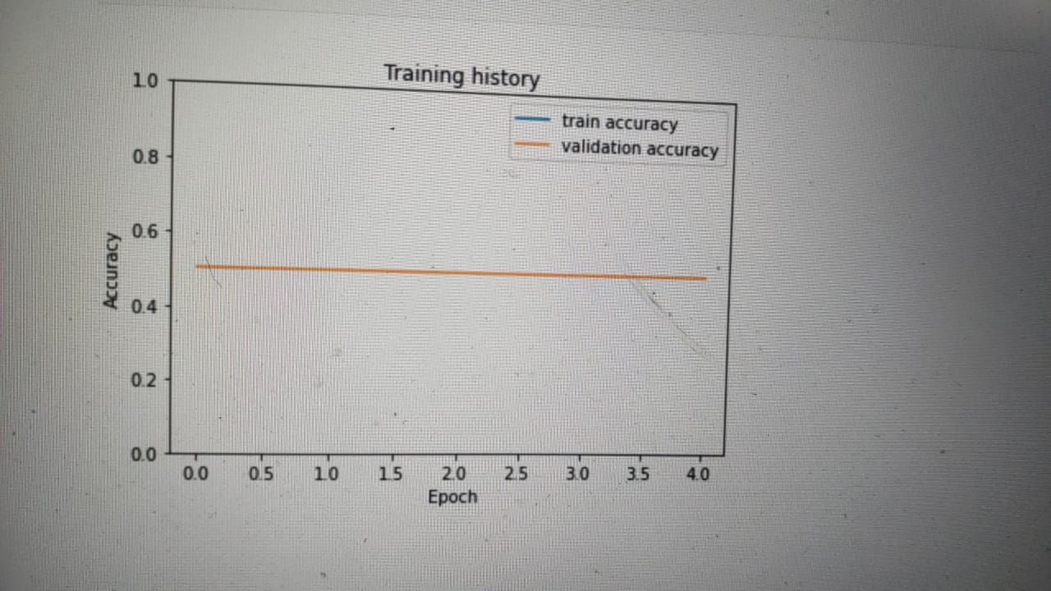
Fig 4.1: Graph of trained dataset

Slide 28
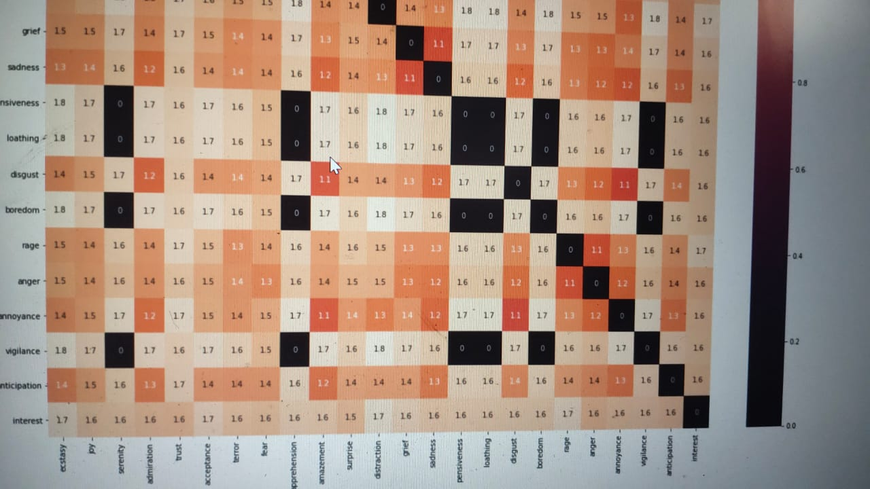
Fig 4.1: Graph of sentiment analysis

Slide 29
Limitations
We are focusing only focus on 3 steps of Product Marketing but not Product Marketing Strategy.
Future Scope
Complete working program on Product Marketing .
Recommending the product by using Collaborative Filtering.

Slide 30
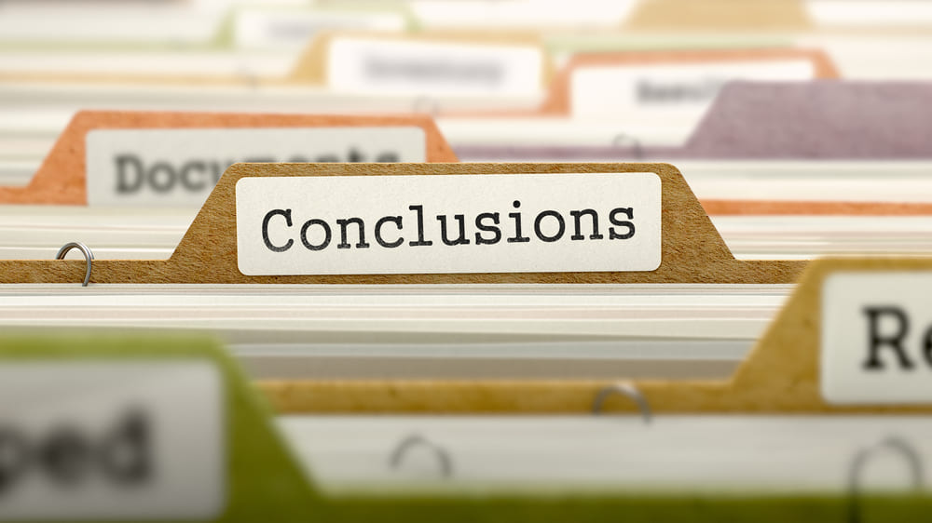
Conclusion
With the help of this project we can easily
Find our TARGET AUDIENCE
Their INTERESTS
RECOMMEND and SUGGEST a product
ANALYZE the product ratings

Slide 31
THANK YOU

